Slide 1
moodfood
by 4 foodies
Chelsey Dolan, Anna Ly,
Justin McLaren, and Simeon Utubor
Notes:
Anna

Slide 2
Notes:
Anna

Slide 3
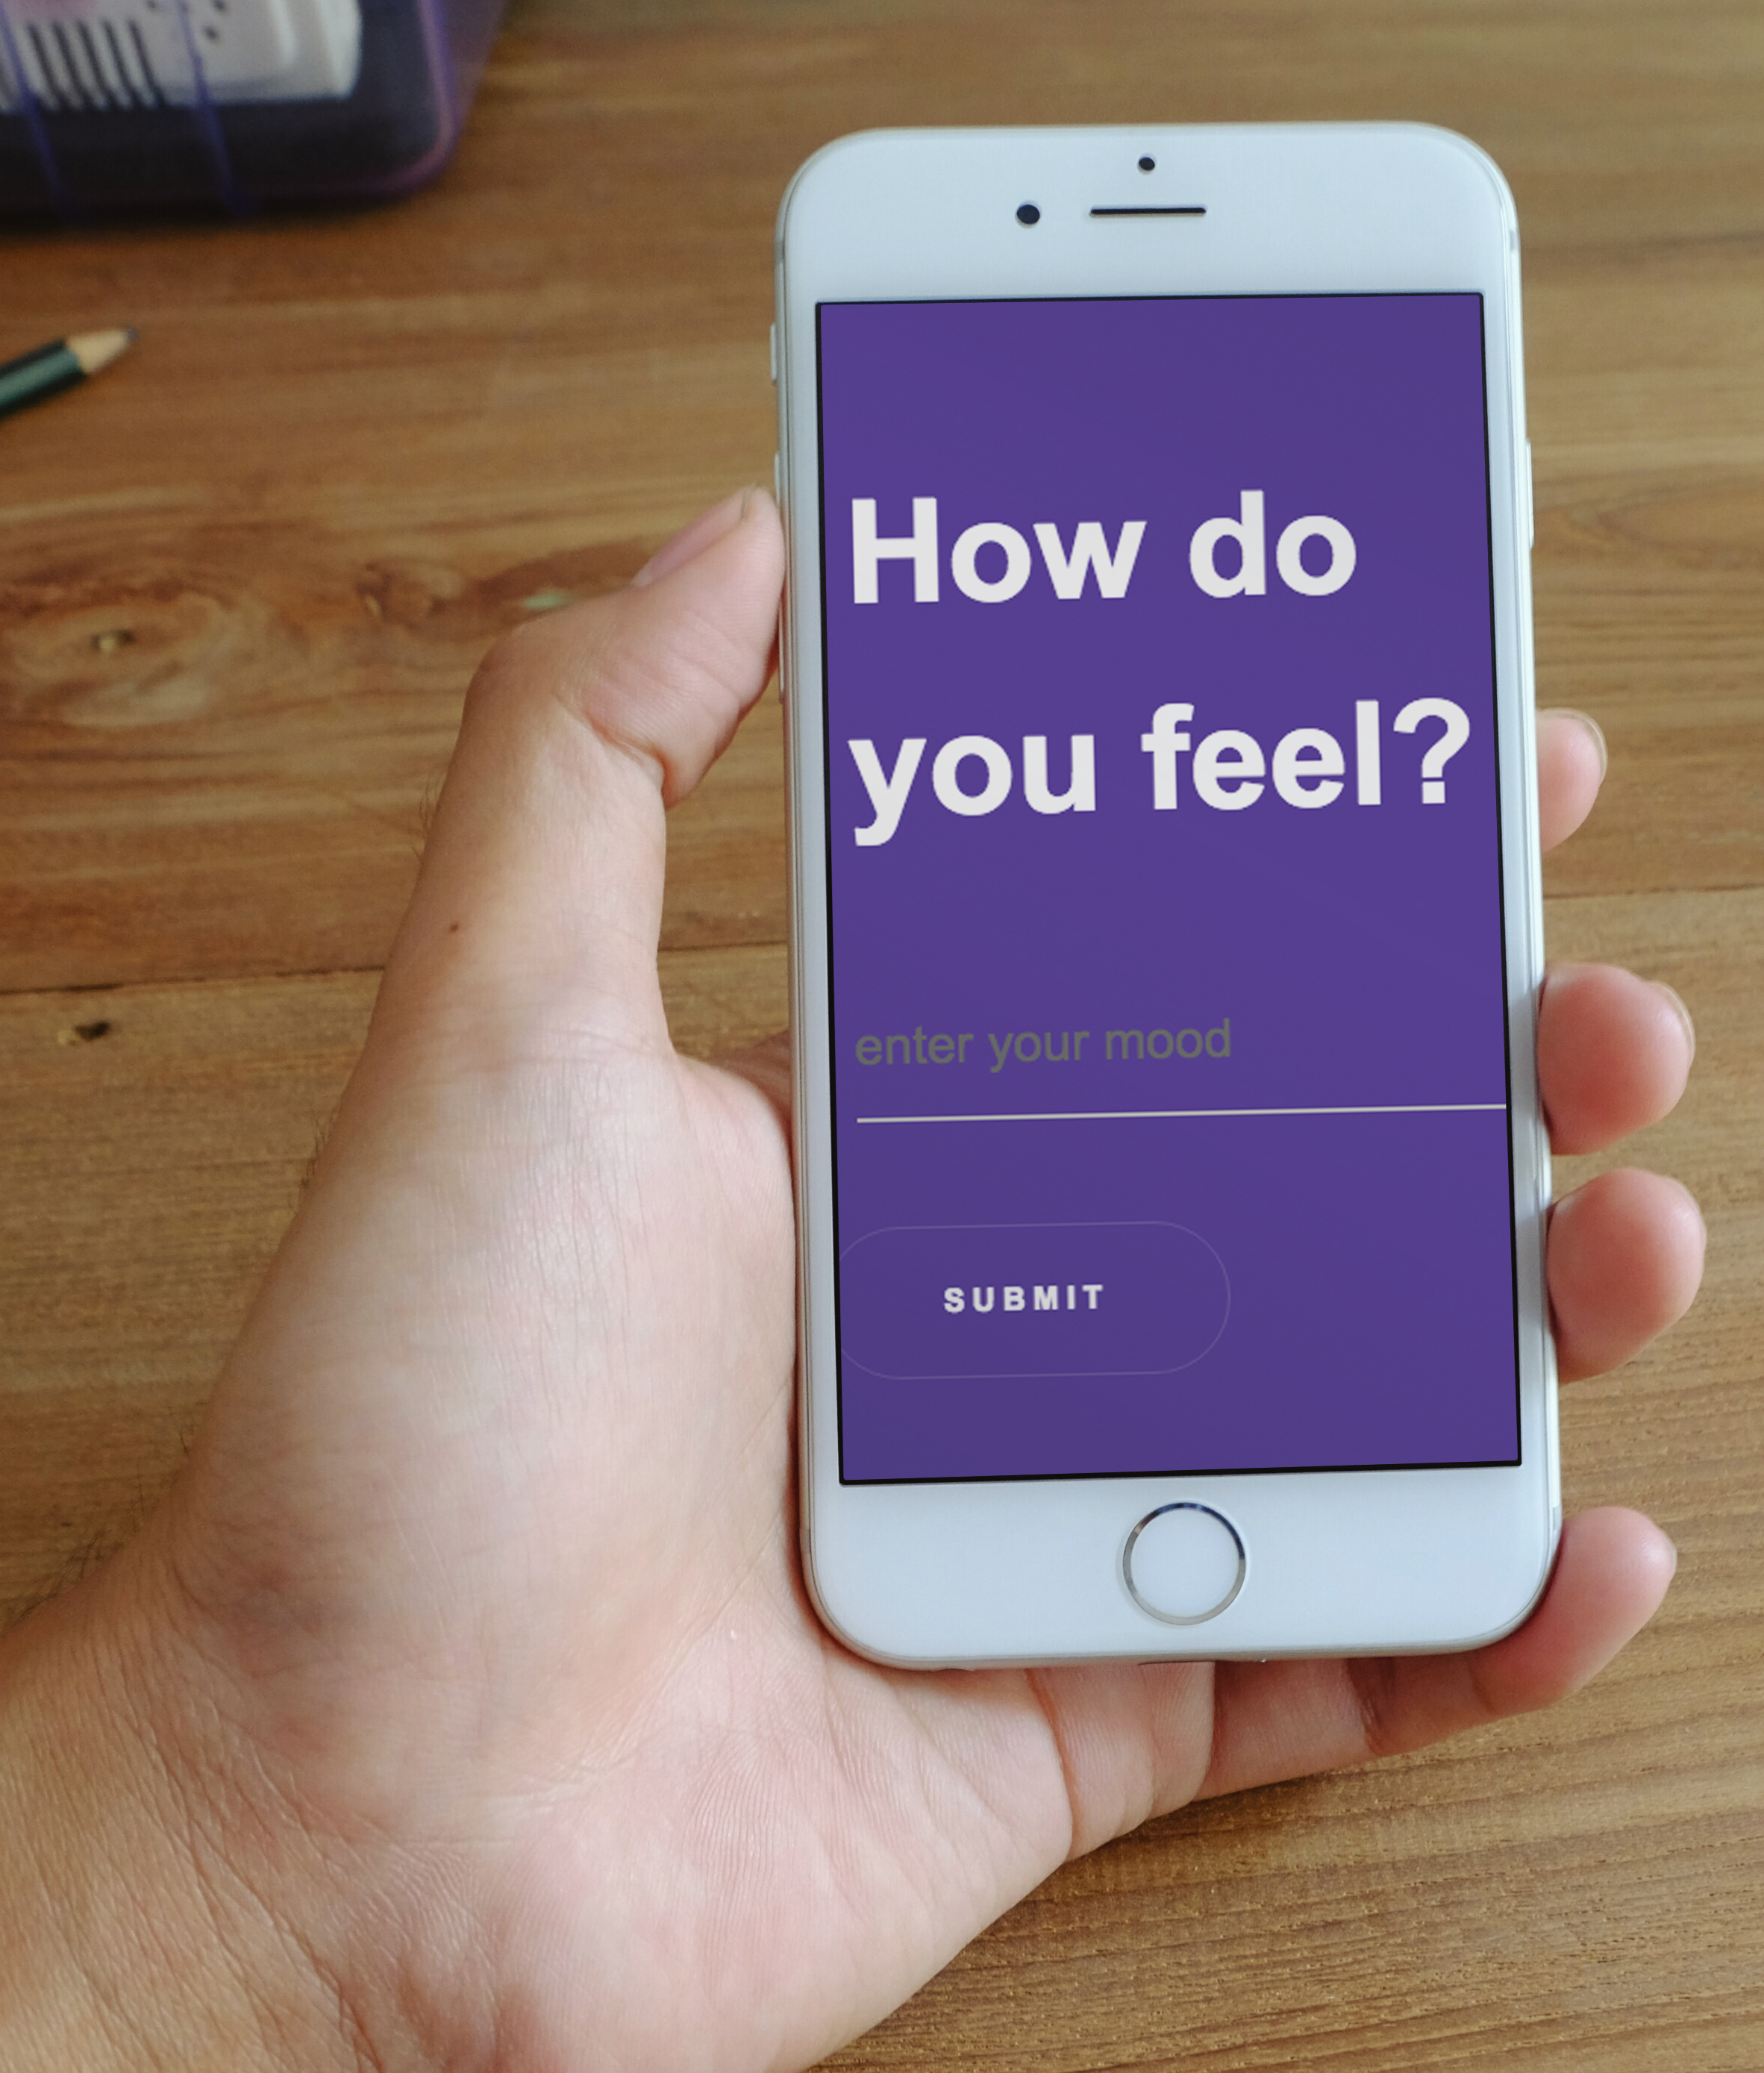
C O N C E P T
Helps answer the age-old question: “What should I eat?”
Brings you one food option nearest you based on your mood
User types in current mood and will be provided with a food option closest to their zip code
User-friendly and simple
Notes:
Anna
Your overall application’s concept:
Revolves around answering the age-old question “What should I eat?”
The motivation for its development:
Websites like Yelp.com provides multiple options which can oftentimes be overwhelming and complicate the process of deciding on ONE place. Our app cuts down that process by providing users with one food option based on their mood.

Slide 4
D E V E L O P M E N T
Front-End:
Anna and Justin
HTML 5
CSS 3
Bootstrap
jQuery
Animate.css
Back-End:
Chelsey and Simeon
JavaScript
jQuery
Google Places & Maps API
Indico API
Firebase
Notes:
Justin
The technologies used (and briefly how they work)

Slide 5
D E S I G N
Simple, sleek, and user-friendly app development
Hand-drawn wireframe, Photoshop prototype, simple HTML and CSS, then a robust UI/UX working app
Integrated back-end with front-end ensuring proper data was pulled from APIs, including Google Maps
Notes:
Justin
Design process
Front-end: Started off with hand sketched ideas turned into a simple prototype created on Photoshop. After we used HTML and CSS to turn this prototype into a webpage.
Back-end: used Google Places and Watson API

Slide 6
P A R A M E T E R S
Distance (max: 5 mile radius)
Ratings (3.5 stars or greater)
Open now
Prominence
User’s longitude and latitude
Notes:
Chelsey

Slide 7
D E M O
Check it out:
https://chelseymarie6.github.io/moodfood/
Notes:
Chelsey
A demonstration of its functionality

Slide 8
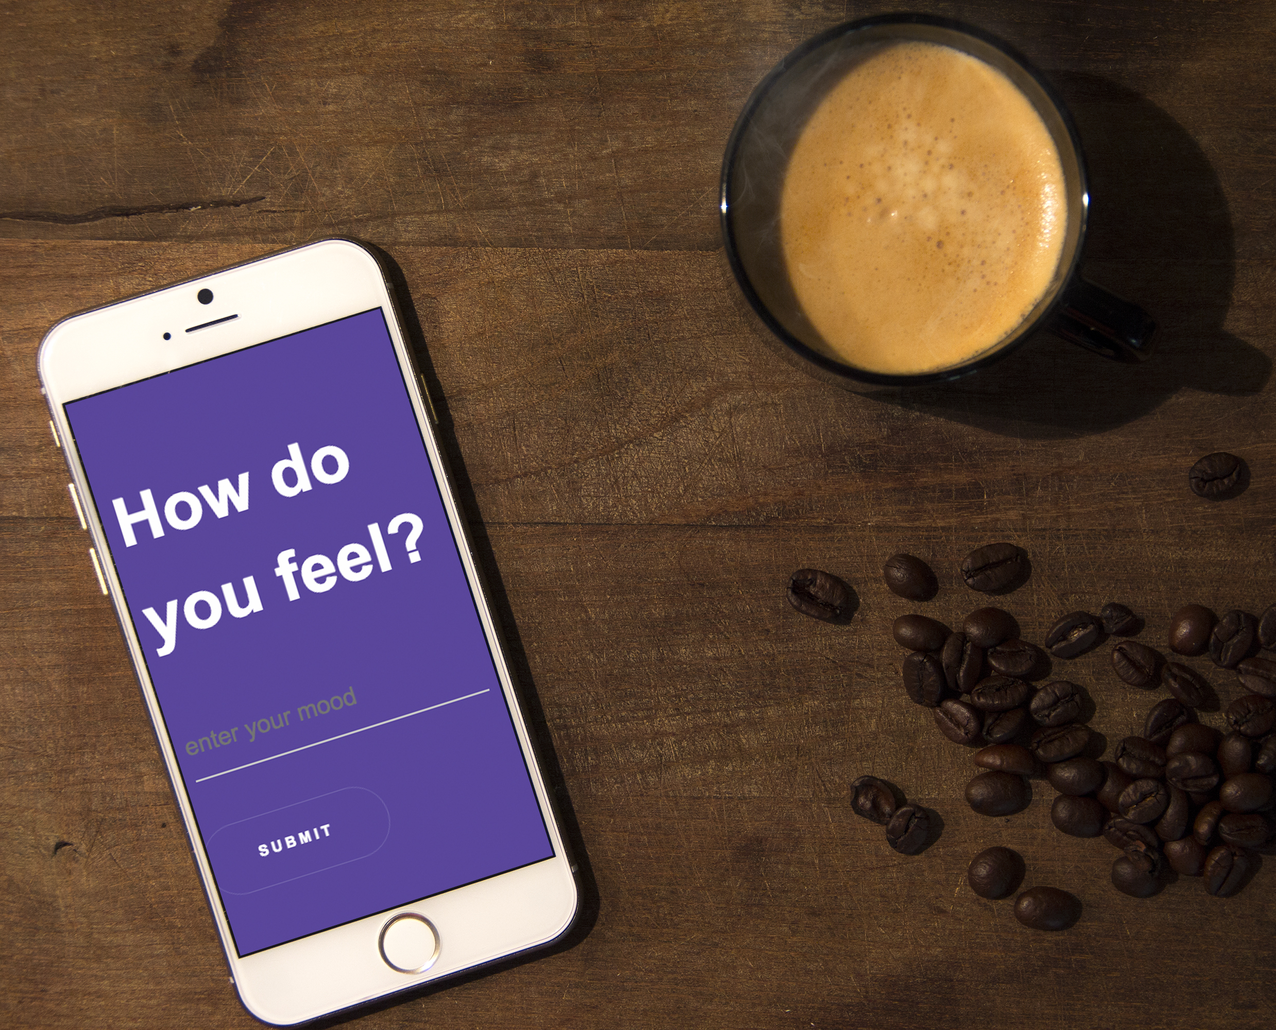
F U T U R E D E V E L O P M E N T
Voice-input
Dynamic parameters
Collecting data from users’ demographics through login
Providing multiple results based on user’s preference
Notes:
Simeon
Directions for future development
Using Firebase to store the user’s moods and the result our app is providing to gather data on the average usage of app and typical location
Dynamic mapping of mood to food
Dynamic in the restaurant responses.
Currently, we are asking a text input from the user for their mood. With future development, our application has the potential to interpolate a user’s emotion based on voice-input and then provide a food suggestion.
Additional factors beyond the parameters we selected (categorical style food selection, ratings, and location) could include:
User login/profile to keep track of their moods and food choices to ensure dynamic recommendations are being made
Integration with other apps such as a user’s calendar to plan ahead for meals
Could incorporate recipes, and/or grocery services beyond providing restaurant choices

Slide 9
Q U E S T I O N S ?

